Slide 1
Undecimated wavelet transform (Stationary Wavelet Transform)
ECE 802

Slide 2
Standard DWT
Classical DWT is not shift invariant: This means that DWT of a translated version of a signal x is not the same as the DWT of the original signal.
Shift-invariance is important in many applications such as:
  Change Detection
  Denoising
  Pattern Recognition

Slide 3
E-decimated wavelet transform
In DWT, the signal is convolved and decimated (the even indices are kept.)
The decimation can be carried out by choosing the odd indices.
If we perform all possible DWTs of the signal, we will have 2J decompositions for J decomposition levels.
Let us denote by εj = 1 or 0 the choice of odd or even indexed elements at step j. Every ε decomposition is labeled by a sequence of 0's and 1's. This transform is called the ε-decimated DWT.

Slide 4
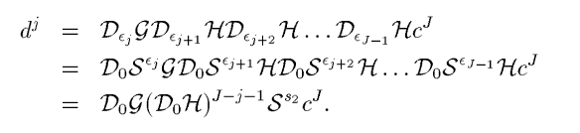
ε-decimated DWT are all shifted versions of coefficients yielded by ordinary DWT applied to the shifted sequence.

Slide 5
SWT
Apply high and low pass filters to the data at each level
Do not decimate
Modify the filters at each level, by padding them with zeroes
Computationally more complex

Slide 6
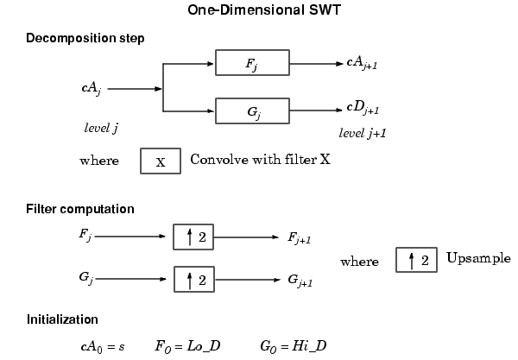
Block Diagram of SWT

Slide 7
SWT Computation
Step 0 (Original Data):
A(0) A(0) A(0) A(0) A(0) A(0) A(0) A(0)
Step 1:
D(1,0)D(1,1)D(1,0)D(1,1)D(1,0)D(1,1)D(1,0)D(1,1)
A(1,0)A(1,1) A(1,0)A(1,1) A(1,0)A(1,1) A(1,0)A(1,1)

Slide 8
SWT Computation
Step 2:
D(1,0)D(1,1) D(1,0)D(1,1) D(1,0)D(1,1) D(1,0)D(1,1)
D(2,0,0)D(2,1,0)D(2,0,1)D(2,1,1) D(2,0,0)D(2,1,0)D(2,0,1)D(2,1,1)
A(2,0,0)A(2,1,0)A(2,0,1)A(2,1,1) A(2,0,0)A(2,1,0)A(2,0,1)A(2,1,1)

Slide 9
Different Implementations
A Trous Algorithm: Upsample the filter coefficients by inserting zeros
Beylkin’s algorithm: Shift invariance, shifts by one will yield the same result by any odd shift. Similarly, shift by zero→All even shifts.
  Shift by 1 and 0 and compute the DWT, repeat the same procedure at each stage
  Not a unique inverse: Invert each transform and average the results

Slide 10
Different Implementations
Undecimated Algorithm: Apply the lowpass and highpass filters without any decimation.

Slide 11
Continuous Wavelet Transform (CWT)

Slide 12



CWT
Decompose a continuous time function in terms of wavelets:
Can be thought of as convolution
Translation factor: a, Scaling factor: b.
Inverse wavelet transform:

Slide 13
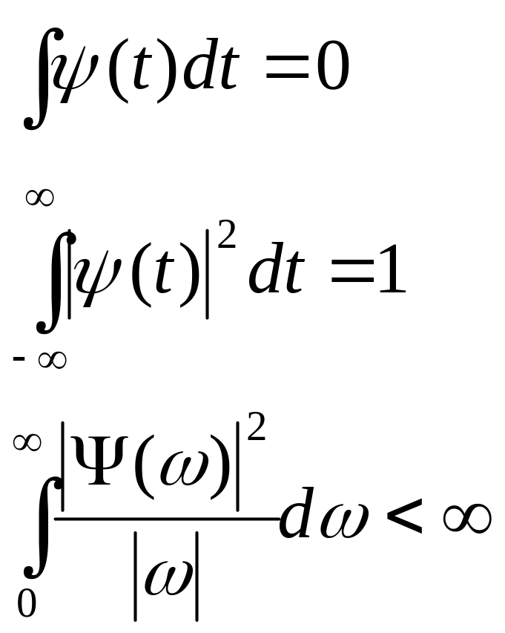
Requirements on the Mother wavelet

Slide 14
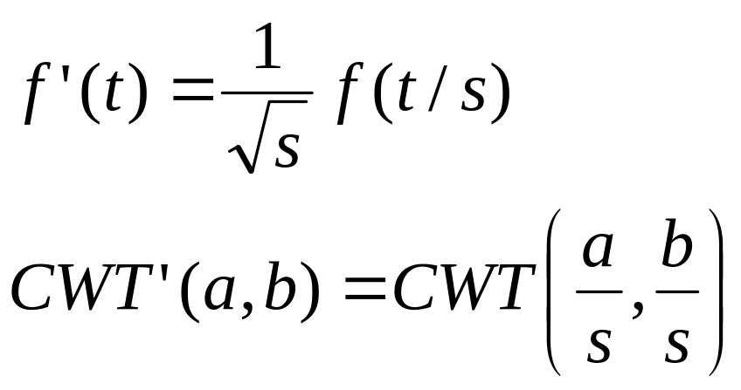
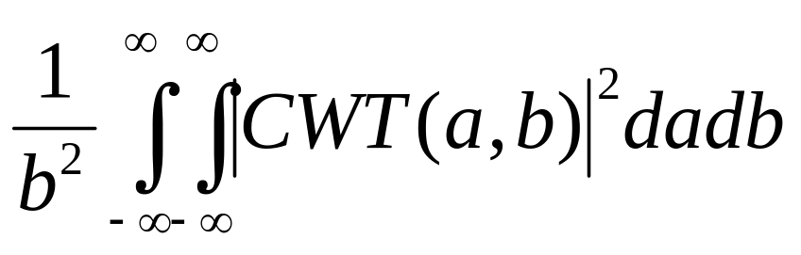
Properties
Linearity
Shift-Invariance
Scaling Property:
Energy Conservation: Parseval’s

Slide 15
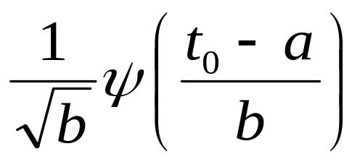
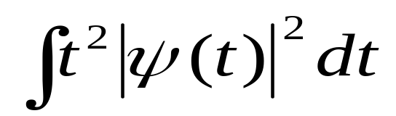
Localization Properties
Time Localization: For a Delta function,
The time spread:
Frequency localization can be adjusted by choosing the range of scales
Redundant representation

Slide 16
CWT Examples
The mother wavelet can be complex or real, and it generally includes an adjustable parameter which controls the properties of the localized oscillation.
Complex wavelets can separate amplitude and phase information.
Real wavelets are often used to detect sharp signal transitions.

Slide 17
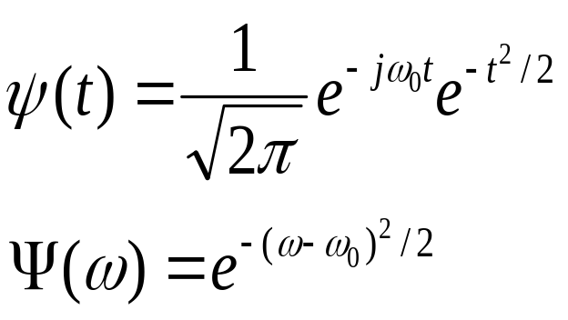
Morlet Wavelet
Morlet: Gaussian window modulated in frequency, normalization in time is controlled by the scale parameter

Slide 18

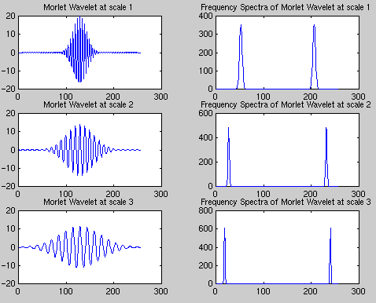
Morlet Wavelet
Real part:

Slide 19
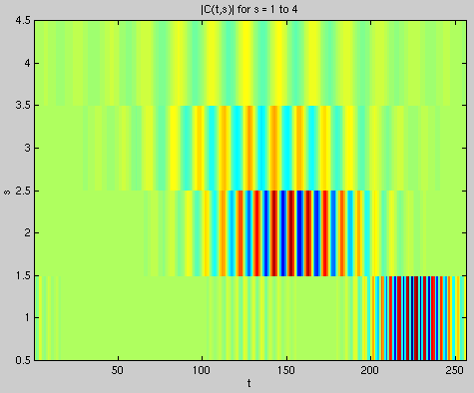
CWT
CWT of chirp signal:

Slide 20

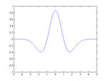
Mexican Hat
Derivative of Gaussian (Mexican Hat):

Slide 21
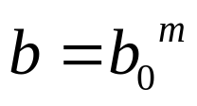
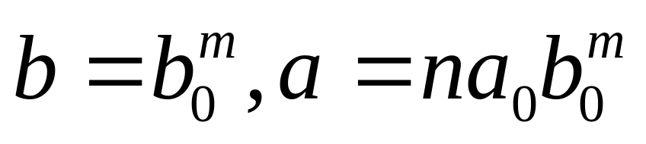
Discretization of CWT
Discretize the scaling parameter as
The shift parameter is discretized with different step sizes at each scale
Reconstruction is still possible for certain wavelets, and appropriate choice of discretization.

